Slide 1
Puzzling Perimeter - 1

Slide 2






What’s the perimeter of the rectangle?
Puzzling Perimeter - 1
(not drawn to scale)
$11$
$a$
$9−a$
$$45°$$
$9−a$
$9$

Slide 3




What’s the perimeter of the rectangle?
Puzzling Perimeter - 1
(not drawn to scale)
$11$
$a$
$11−b$
$$45°$$
$11−b$
$9−a$
$$45°$$
$9−a$
$b$
$9$

Slide 4

What’s the perimeter of the rectangle?
Puzzling Perimeter - 1
(not drawn to scale)
$11$
$a$
$11−b$
$$45°$$
$11−b$
$9−a$
$$45°$$
$9−a$
$b$
$9$

Slide 5

What’s the perimeter of the rectangle?
Puzzling Perimeter - 1
(not drawn to scale)
$11$
$a$
$11−b$
$$45°$$
$11−b$
$9−a$
$$45°$$
$9−a$
$b$
$9$
Perimeter = $(11+a)+(9−a)+\left(9+b\right) +(11−b) = 40$

Slide 6
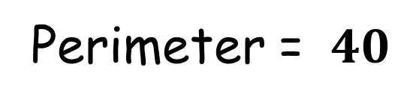
What’s the perimeter of the rectangle?
Puzzling Perimeter - 1
(not drawn to scale)
$11$
$$45°$$
$9$
Perimeter = $40$

Slide 7
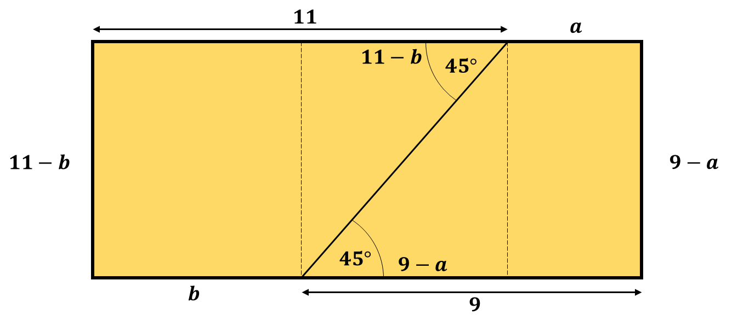
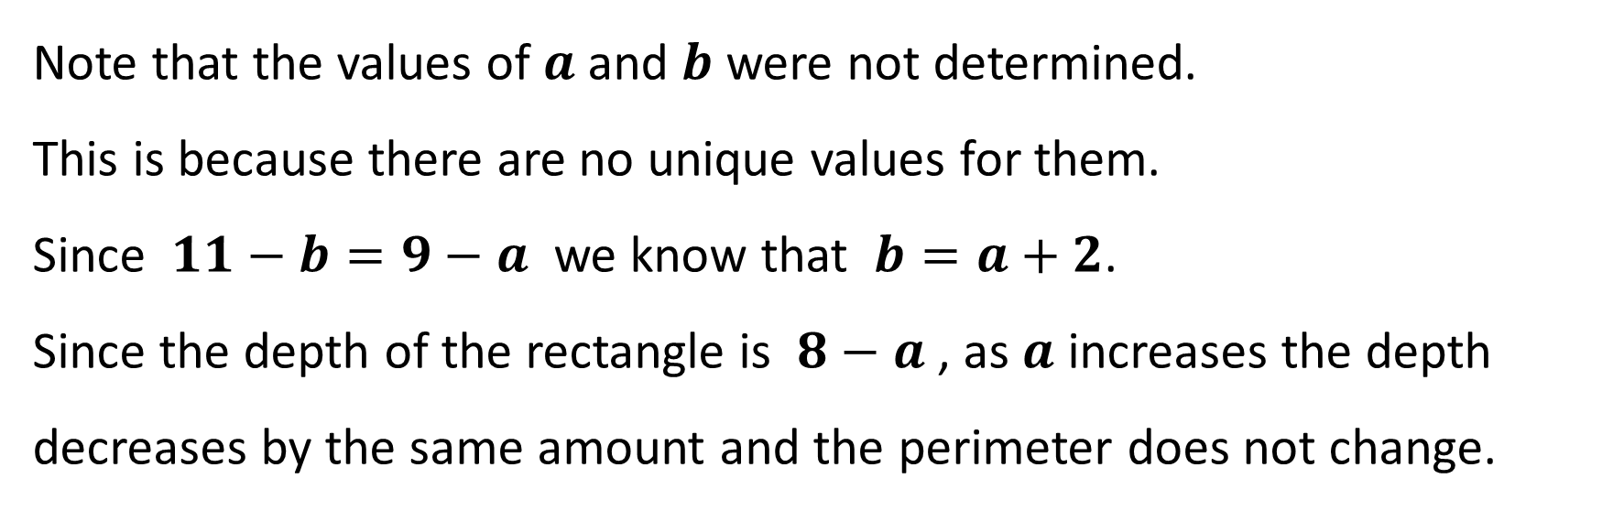
Puzzling Perimeter - 1
Note that the values of $a$ and $b$ were not determined.
This is because there are no unique values for them.
Since $11−b=9−a$ we know that $b=a+2$.
Since the depth of the rectangle is $8−a$ , as $a$ increases the depth decreases by the same amount and the perimeter does not change.

Slide 8
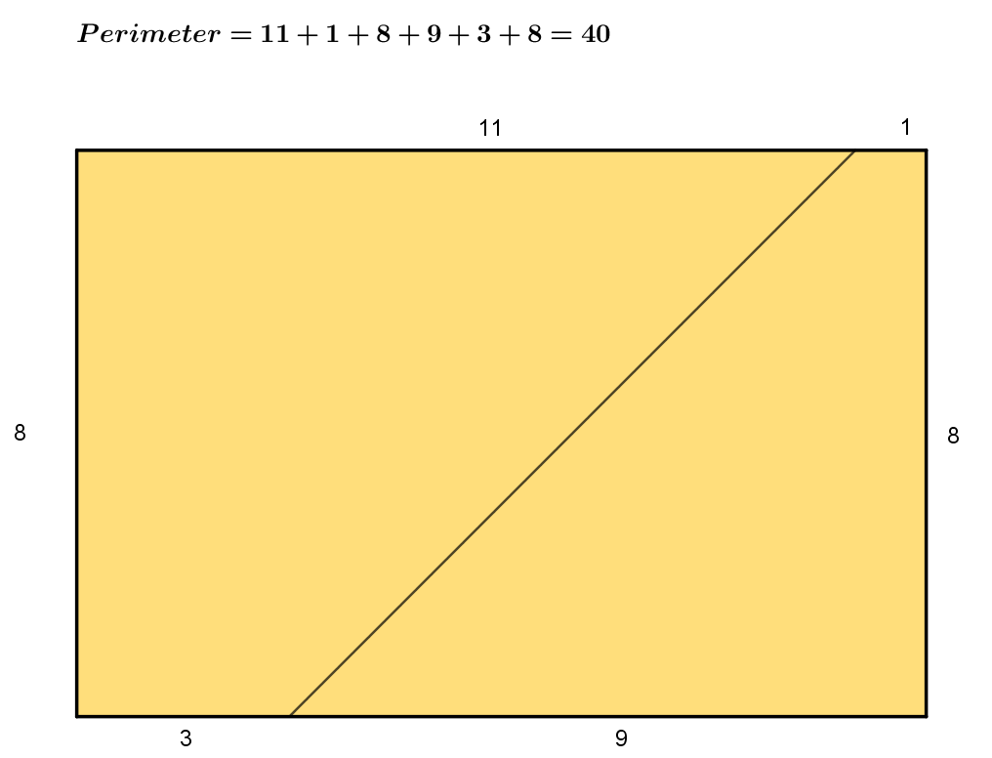
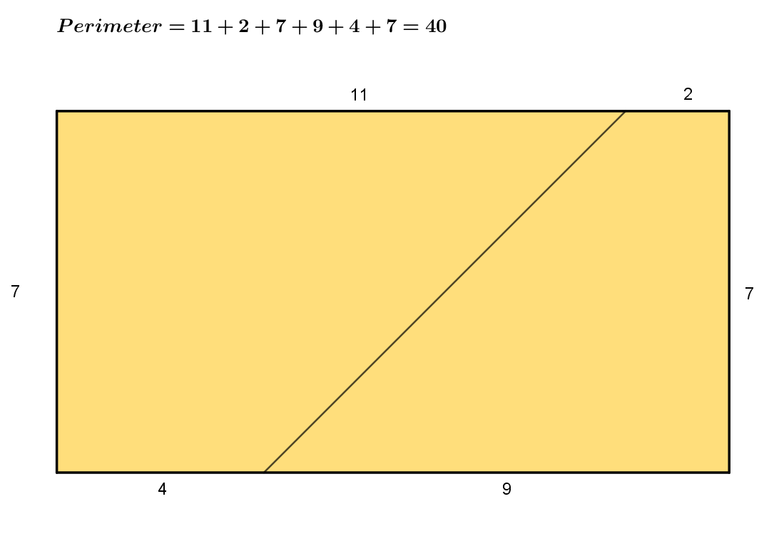
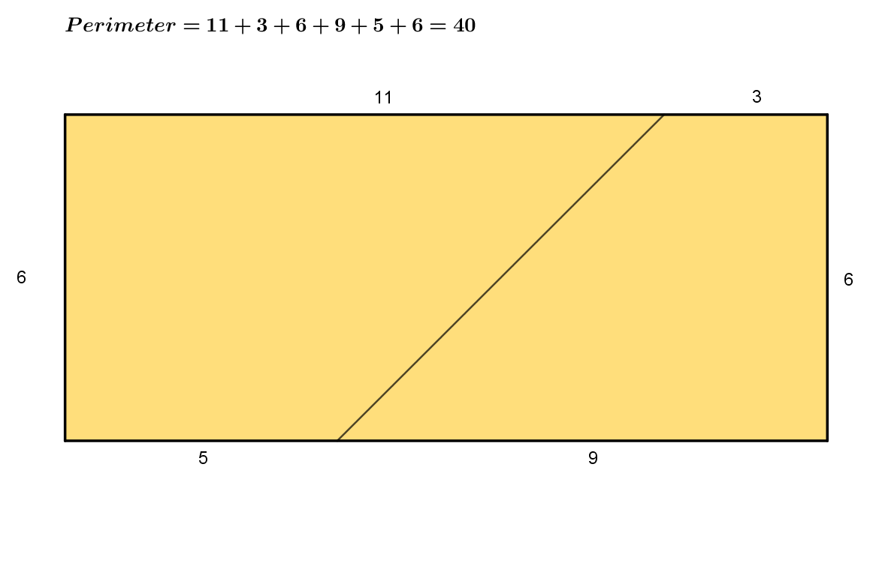
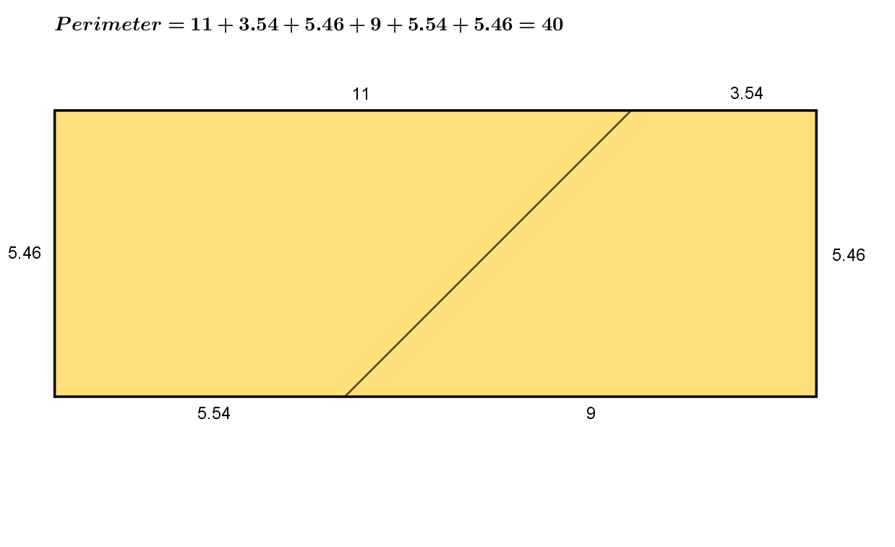
Some examples

Slide 10
Note to Teacher
The answers are not all the same.
The answer is simply the sum of the two numbers, doubled.

Slide 11
Resources

Slide 12



What’s the perimeter of the rectangle?
Puzzling Perimeter - 1
SIC_91
(not drawn to scale)
$10$
$$45°$$
$8$

Slide 13


What’s the perimeter of the rectangle?
Puzzling Perimeter - 1
SIC_91
(not drawn to scale)
$12$
$$45°$$
$8$

Slide 14


What’s the perimeter of the rectangle?
Puzzling Perimeter - 1
SIC_91
(not drawn to scale)
$7$
$$45°$$
$5$

Slide 15

What’s the perimeter of the rectangle?
Puzzling Perimeter - 1
SIC_91
(not drawn to scale)
$7$
$$45°$$
$3$

Slide 16


What’s the perimeter of the rectangle?
Puzzling Perimeter - 1
SIC_91
(not drawn to scale)
$22$
$$45°$$
$15$

Slide 17

What’s the perimeter of the rectangle?
Puzzling Perimeter - 1
SIC_91
(not drawn to scale)
$22$
$$45°$$
$21$

Slide 18


What’s the perimeter of the rectangle?
Puzzling Perimeter - 1
SIC_91
(not drawn to scale)
$14$
$$45°$$
$11$

Slide 19


What’s the perimeter of the rectangle?
Puzzling Perimeter - 1
SIC_91
(not drawn to scale)
$11$
$$45°$$
$15$

Slide 20

What’s the perimeter of the rectangle?
Puzzling Perimeter - 1
SIC_91
(not drawn to scale)
$10$
$$45°$$
$17$

Slide 21



What’s the perimeter of the rectangle?
Puzzling Perimeter - 1
SIC_91
(not drawn to scale)
$50$
$$45°$$
$35$

Slide 22


What’s the perimeter of the rectangle?
Puzzling Perimeter - 1
SIC_91
(not drawn to scale)
$32$
$$45°$$
$24$

Slide 23


What’s the perimeter of the rectangle?
Puzzling Perimeter - 1
SIC_91
(not drawn to scale)
$17$
$$45°$$
$25$

Slide 24


What’s the perimeter of the rectangle?
Puzzling Perimeter - 1
SIC_91
(not drawn to scale)
$37$
$$45°$$
$40$

Slide 25

What’s the perimeter of the rectangle?
Puzzling Perimeter - 1
SIC_91
(not drawn to scale)
$22$
$$45°$$
$13$

Slide 26


What’s the perimeter of the rectangle?
Puzzling Perimeter - 1
SIC_91
(not drawn to scale)
$28$
$$45°$$
$22$

Slide 27

What’s the perimeter of the rectangle?
Puzzling Perimeter - 1
SIC_91
(not drawn to scale)
$39$
$$45°$$
$21$

Slide 28


What’s the perimeter of the rectangle?
Puzzling Perimeter - 1
SIC_91
(not drawn to scale)
$17$
$$45°$$
$33$

Slide 29


What’s the perimeter of the rectangle?
Puzzling Perimeter - 1
SIC_91
(not drawn to scale)
$120$
$$45°$$
$127$

Slide 30

What’s the perimeter of the rectangle?
Puzzling Perimeter - 1
SIC_91
(not drawn to scale)
$35$
$$45°$$
$40$

Slide 31


What’s the perimeter of the rectangle?
Puzzling Perimeter - 1
SIC_91
(not drawn to scale)
$27$
$$45°$$
$13$

Slide 32


What’s the perimeter of the rectangle?
Puzzling Perimeter - 1
SIC_91
(not drawn to scale)
$38$
$$45°$$
$32$

Slide 33


What’s the perimeter of the rectangle?
Puzzling Perimeter - 1
SIC_91
(not drawn to scale)
$19$
$$45°$$
$31$

Slide 34

What’s the perimeter of the rectangle?
Puzzling Perimeter - 1
SIC_91
(not drawn to scale)
$19$
$$45°$$
$41$

Slide 35


What’s the perimeter of the rectangle?
Puzzling Perimeter - 1
SIC_91
(not drawn to scale)
$10$
$$45°$$
$20$

